Slide 1
Cs-381 Software Engineering
Course Instructor: Dr. Shazia Arshad
Notes:
Welcome to all of you in this course. I am Dr. Shazia Arshad. I will be your instructor for this course.

Slide 2

Software DESIGN
Notes:
What is Software Design?
A process to transform user requirements into some suitable form, which helps the programmer in software coding and implementation.
Design is the bridge between problem domain and its solution in the sense that it guides the software engineer how to convert problem in some meaningful solution through graphical interfaces.
It is transforming a requirement specification into a detailed description of the software that's code ready.
Software design is all about designing a solution, creating the deliverables and documentation necessary to allow the developing team to build something that meets the needs of the user or the client.
Software Design is all about converting a Natural Language Solution into Code Ready Solution.
When designing software, diagramming the flow, components, structures, elements, complexities and their relations are a great way to depict the system. Communication within the team and with stakeholders becomes easy with a graphical layout.
Example:
Tom and Jerry are best friends who lived in separate towns. Tom is angry with his friend Jerry. Jerry wants to make Tom happy and surprise him by visiting his house.
Here, the problem is How to make TOM happy.
The solution is by visiting TOM’s house. It is called Natural Language Solution.
Providing exact route map from Jerry’s house to Tom’s house is the code-ready solution of this problem.

Slide 3
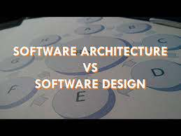
Difference
Notes:
Architecture and design concerns often overlap. Rather than use hard and fast rules to distinguish between architecture and design, it makes sense to combine them. This combined stage could be called architectural design. In some cases, decisions are clearly more architectural in nature. In other cases, decisions focus heavily on design and how it helps to realize that architecture.
What is meant by structure of the system?
What are modules of system?
So, before continuing ahead, let’s look at the roles of both of them.
Software architecture exposes the structure of a system while hiding the implementation details. Architecture also focuses on how the elements and components within a system interact with one other.
Software design delves deeper into the implementation details of the system. Design concerns include the selection of data structures and algorithms, or the implementation details of individual components.
Software Architecture and Design Users?
Software architecture involves communication with business stakeholders' while software design just uses the guidelines to create design of the system.
Software architecture involves fundamental properties of the system while software design include detailed properties.
All architectures involve design but NOT all the designs involve architecture.

Slide 4
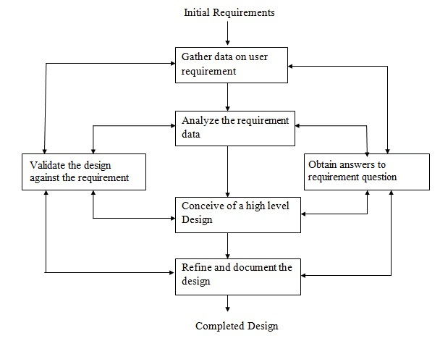
Design Process
Notes:
The design process as shown in the slide above is majorly classified into three major categories:
Gathering Requirements
Refining Requirements
Validation and Testing
Preparing High Level Design
The design process begins by examining the user requirements. These user requirements are then translated to obtain answers to user questions. It involves answering the questions of user problems.
What are user problems?
How the user requirements can be solved or what are the solutions to these problems?
Next step is either to refine user requirements by focusing or analyzing it or prepare the initial flow of your project which is called initial design.
The initial design prepared in the previous stage is then tested to check against user requirements. In this step, every user requirement is tested if it qualifies according to client’s need or not. If there is any gap in the design or the requirement which further need to be elaborated to make it flow clear, then the loop starts again. Once again, the requirements are put into consideration after validating the initial design.
This loop continues to run as long as the requirements are fully finalized. Then, the final design document is prepared.

Slide 5

Software Design Levels
Software Requirements Specification
High-level Design
Detailed Design
Notes:
Design phase of SDLC can be divided into multiple levels. It is up to the project manager or team lead that into how many levels you want to divide your design document.
Generally, the design level is split into three major levels:
Software requirements specification. This document describes the expected behavior of the system in the form of functional and non-functional requirements. These requirements should be clear, actionable, measurable, and traceable to business requirements. Requirements should also define how the software should interact with humans, hardware, and other systems.
High-level design. The high-level design breaks the system’s architectural design into a less-abstracted view of sub-systems and modules and depicts their interaction with each other. This high-level design perspective focuses on how the system, along with all its components, implements in the form of modules. It recognizes the modular structure of each sub-system and their interaction among one another.
Detailed design. Detailed design involves the implementation of what is visible as a system and its sub-systems in a high-level design. This activity is more detailed towards modules and their implementations. It defines a logical structure of each module and their interfaces to communicate with other modules.

Slide 6

Design principles
Modularity
Notes:
Modularity:
Modularity specifies to the division of software into separate modules which are differently named and addressed and are integrated later on in to obtain the completely functional software. It is the only property that allows a program to be intellectually manageable. Single large programs are difficult to understand and read due to many reference variables, control paths, global variables, etc.
Example:
Software development is the most complex thing we as humans have ever done. Building a bridge is hard, but you can see it. You can roll a truck across it, watch and see if the bridge collapses or sways or cracks while you're doing that. There are physical world properties that can be monitored to find defects early during construction. Software isn't like that. You may never know there's a huge crack down the main line of your program. Attempting to hold the entire concept of a large-scale program in your mind all is a great mistake. We have no choice but to break the problem down into smaller parts which we might then be able to comprehend. To do that properly, we're going to focus on major concepts like Decomposability. Essentially, it's the ancient, possibly Roman, concept of divide and conquer. When the problem is too large and complex to get a proper handle on it, breaking it down into smaller parts until you can solve the smaller part is the way to go. Then you just solve all the smaller parts. But then we must put all those smaller parts back together and that's where composability comes into play. This is often not as simple as one would like.
The desirable properties of a modular system are:
Each module is a well-defined system that can be used with other applications.
Each module has single specified objectives.
Modules can be separately compiled and saved in the library.
Modules should be easier to use than to build.
The concept of modularity composed of four major aspects:
Coupling
Cohesion
Information Hiding
Data Encapsulation
These will be discussed in the next slides.
Advantages of modularity:
It allows large programs to be written by several or different people
It encourages the creation of commonly used routines to be placed in the library and used by other programs.
It simplifies the overlay procedure of loading a large program into main storage.
It provides a framework for complete testing, more accessible to test.
It produced the well designed and more readable program.
Disadvantages of Modularity
Execution time maybe, but not certainly, longer
Storage size perhaps, but is not certainly, increased
Compilation and loading time may be longer
Inter-module communication problems may be increased
More linkage required, run-time may be longer, more source lines must be written, and more documentation has to be done.

Slide 7

Design principles
Abstraction
Notes:
Abstraction
An abstraction is a tool that enables a designer to consider a component at an abstract level without bothering about the internal details of the implementation. Abstraction can be used for existing element as well as the component being designed.
Example:
Take example - printing a document from your computer. You just open the document, click on the “print” command, and in a short while, the printed document is ready. You are not really bothered about how the computer stores the document in 0s and 1s, nor about how it is transferred to the printer.
Here, there are two common abstraction mechanisms
Functional Abstraction
Data Abstraction
Functional Abstraction
In designing a modular solution (algorithm) to your computing problems, each module should be independent of the method that the other modules use to solve their part of the problem. You should be able to change the code in a module without affecting any of the other modules, as long as the interface remains the same. This isolates the parts of the problem from each other, so that you only need to worry about a small part of the overall problem at any time. The separation of the purpose of a module from its implementation is called functional abstraction. This principle is useful for writing individual functions, even if they are only a small part of a module. If you know the input and output, pre-conditions and post-conditions of the function, then you don’t need to know how it works to use it as part of a specific module or larger piece of software.
Data Abstraction
Like functional abstraction, we will use data abstraction. An abstract data type or ADT is a collection of data and a set of operations on the data (for example, a list of records) that does not specify how the data is stored or how the operations accomplish their functions. The ADT can be used in software design without knowing how it will be implemented. Examples of abstract data types are lists, stacks, queues, and trees.
Data abstraction is one of the most essential and important features of object-oriented programming in C++. Abstraction means displaying only essential information and hiding the details. Data abstraction refers to providing only essential information about the data to the outside world, hiding the background details or implementation.
Details of the data elements are not visible to the users of data. Data Abstraction forms the basis for Object Oriented design approaches.

Slide 8
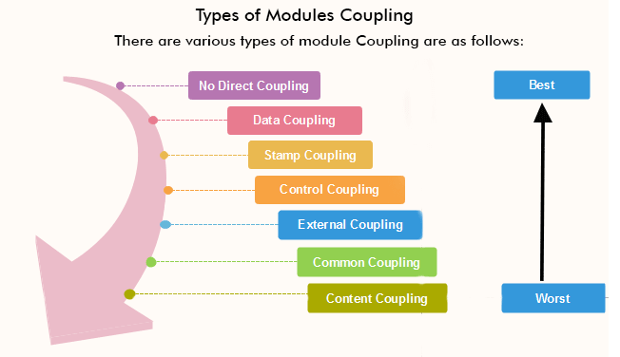
Design principles
Coupling
Notes:
Coupling
Coupling refers to the degree to which the different modules/classes depend on each other, it is suggested that all modules should be independent as far as possible, that's why low coupling. It has to do with the elements among different modules/classes.
In software engineering, the coupling is the degree of interdependence between software modules. Two modules that are tightly coupled are strongly dependent on each other. However, two modules that are loosely coupled are not dependent on each other. Uncoupled modules have no interdependence at all within them.
Types of Module Coupling:
1. No Direct Coupling:
There is no direct coupling between M1 and M2. In this case, modules are subordinates to different modules. Therefore, no direct coupling (the child of modules interact.))
2. Data Coupling:
When data of one module is passed to another module, this is called data coupling.
3. Stamp Coupling:
Two modules are stamp coupled if they communicate using composite data items such as structure, objects, etc. When the module passes non-global data structure or entire structure to another module, they are said to be stamp coupled. For example, passing structure variable in C or object in C++ language to a module.
4. Common Coupling:
Two modules are called to be common coupled if they share data through some global data items. It is also called global coupling.
5. Control Coupling:
Two modules are called control coupled if one of them decides the functions of other modules or changes its flow of execution. When one module passes parameter to control the activity of another module.
6. Content Coupling:
It shares among two modules if they share code e.g a branch from one module to another module.
7. External Coupling:
It occurs when two modules share an externally imposed data format, communication format or device interface. This is basically related to the communication to external tools and devices.

Slide 9

Coupling Limitations
Notes:
Tightly coupled systems tend to exhibit following developmental characteristics, which are often see as disadvantage.
A change in one module may causes an effect of changing in all other modules.
Assembly of modules might require more effort and time due to increased inter-module dependency.
A particular module might be harder to reuse and or test because dependent modules must be included.

Slide 10
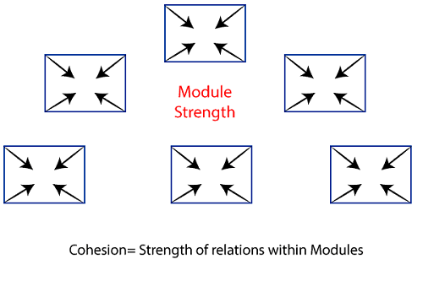
DESIGN PRINCIPLES
Cohesion
Notes:
In computer programming, cohesion defines to the degree to which the elements of a module belong together. Thus, cohesion measures the strength of relationships between pieces of functionality within a given module. For example, in highly cohesive systems, functionality is strongly related. The measure of how strongly the elements are related functionally inside a module is called cohesion in software engineering and the elements inside a module can be instructions, groups of instructions, definition of data, call from another module etc.

Slide 11
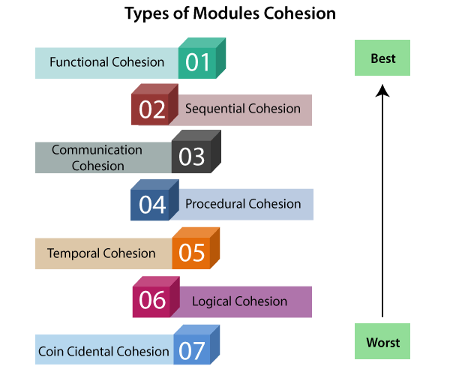
DESIGN PRINCIPLES
Types of Cohesion
Notes:
Types of Cohesion:
Functional Cohesion: Functional Cohesion is said to exist if the different elements of a module, cooperate to achieve a single function.
Sequential cohesion: Sequential cohesion is when parts of a module are grouped because the output from one part is the input to another part like an assembly line.
Communicational/informational cohesion: Communicational cohesion is when parts of a module are grouped because they operate on the same data (e.g. a module which operates on the same record of information).
Procedural cohesion: Procedural cohesion is when parts of a module are grouped because they always follow a certain sequence of execution (e.g. a function which checks file permissions and then opens the file).
Temporal cohesion: Temporal cohesion is when parts of a module are grouped by when they are processed - the parts are processed at a particular time in program execution. When a module includes functions that are associated by the fact that all the methods must be executed in the same time, the module is said to exhibit temporal cohesion (e.g. a function which is called after catching an exception which closes open files, creates an error log, and notifies the user).
Logical Cohesion: A module is said to be logically cohesive if all the elements of the module perform a similar operation. The activities of the same type or same general category is contributed by the elements in the module. Examples of activities of the same type or same general category being contributed by the elements in the module include a report module, display module or input output module. Some of the examples of logical cohesion are module for displaying record as below:
Use type of the record as record.
If type of the record is student. then
Display the record from student.
Coincidental Cohesion: A module is said to have coincidental cohesion if it performs a set of tasks that are associated with each other very loosely, if at all. Some of the examples of coincidental cohesion are module for miscellaneous functions, customer record usage, displaying of customer record, calculation of total sales, reading the transaction record etc.

Slide 12

TIME TO THINK
Differentiate between coupling and cohesion????

